Slide 1
Structures in C++

Slide 2
C++ Structures
A structure is a user-defined data type in C/C++. Structure is a collection of variables of different data types under a single name.
It is similar to a class in that, both holds a collection of data of different data types. The only difference between classes and structs is that, by default, all members of a class are private, and, by default, all members of a struct are public.
For example: You want to store some information about a person: his/her name, citizenship number and salary. You can easily create different variables name, cnic, salary, to store these information separately.
However, in the future, you would want to store information about multiple persons. Now, you'd need to create different variables for each information per person:
name1, cnic1, salary1, name2, cnic2, salary2

Slide 3
Structures: Data Members and Functions
Structures in C++ can contain two types of members:
Data Member: These members are normal C++ variables. We can create a structure with variables of different data types in C++.
Member Functions: These members are normal C++ functions. Along with variables, we can also include functions inside a structure declaration.
struct Rectangle {
// Data Members
int length;
int width;
// Member function to calculate area
int calculateArea() {
return length * width;
}
};

Slide 4
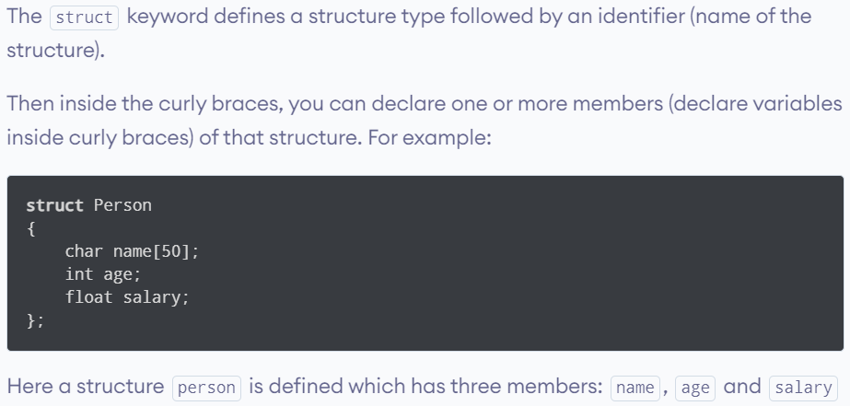
Declaration of structure
When a structure is created, no memory is allocated.

Slide 5
How to initialize structure members?
// In C++ We can Initialize the Variables with Declaration in Structure.
#include <iostream>
using namespace std;
struct Point {
int x = 0; // It is Considered as Default Arguments and no Error is Raised
int y = 1;
};
int main()
{
Point p1;
// No value is Initialized then the default value is considered. ie x=0 and y=1;
cout << "x = " << p1.x << ", y = " << p1.y<<endl;
// Initializing the value of y = 20;
p1.y = 20;
cout << "x = " << p1.x << ", y = " << p1.y;
return 0;
}

Slide 6
How to initialize structure members?
Structure members can be initialized using curly braces ‘{}’. For example, following is a valid initialization.
struct Point {
int x, y;
};
int main()
{
// A valid initialization. member x gets value 0 and y
// gets value 1. The order of declaration is followed.
Point p1 = { 0, 1 };
}

Slide 7
How to define a structure variable?
// A variable declaration with structure declaration.
struct Point
{
int x, y;
} p1; // The variable p1 is declared with 'Point'
// A variable declaration like basic data types
struct Point
{
int x, y;
};
int main()
{
Point p1; // The variable p1 is declared like a normal variable
}
A structure variable can either be declared with structure declaration or as a separate declaration like basic types.

Slide 8
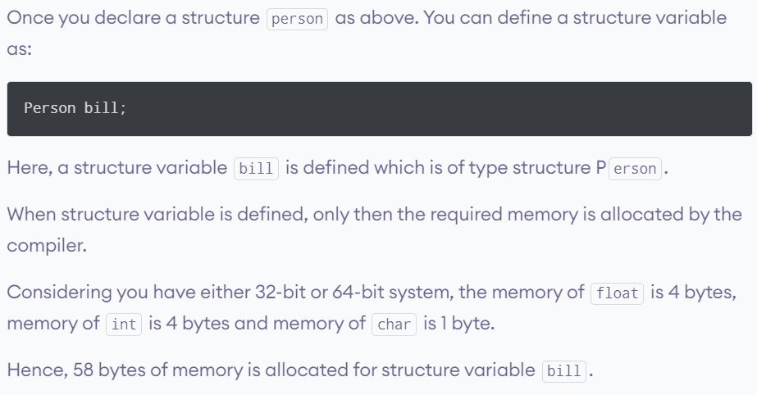
How to define a structure variable?

Slide 9
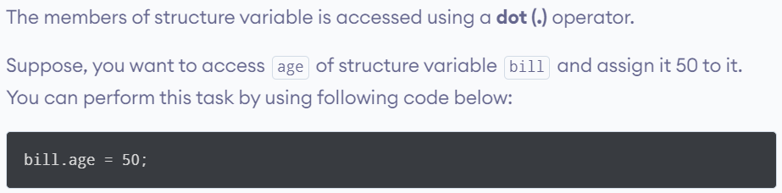
How to access members of a structure?

Slide 10
Example Program
int main() {
Person bill;
cout << "Enter name: ";
cin >> bill.name;
cout << "Enter age: ";
cin >> bill.age;
cout << "Enter salary: ";
cin>>bill.salary;
// Display the details of the bill object
cout << "Name: " << bill.name << endl;
cout << "Age: " << bill.age << endl;
cout << "Salary: " << bill.salary << endl;
return 0;
}
#include <iostream>
using namespace std;
struct Person {
char name[50];
int age;
float salary;
};

Slide 11
C++ Structure and Function
Structure variables can be passed to a function and returned in a similar way as normal arguments.
#include <iostream>
using namespace std;
struct Person {
char name[50];
int age;
float salary;
};
// Function declaration
void displayData(Person);
int main() {
Person p;
cout << "Enter Full name: ";
cin.get(p.name, 50);
cout << "Enter age: ";
cin >> p.age;
cout << "Enter salary: ";
cin >> p.salary;
// Function call with structure variable as an argument
displayData(p);
return 0;
}

Slide 12
C++ Structure and Function
Output:
Enter Full name: Bill Jobs
Enter age: 55
Enter salary: 34233.4
Displaying Information.
Name: Bill Jobs
Age: 55
Salary: 34233.4
void displayData(Person p) {
cout << "\nDisplaying Information." << endl;
cout << "Name: " << p.name << endl;
cout <<"Age: " << p.age << endl;
cout << "Salary: " << p.salary;
}

Slide 13
C++ Pointers to Structure
A pointer variable can be created not only for native types like (int, float, double etc) but they can also be created for user defined types like structure.
This program creates a pointer
ptr of type structure temp.
#include <iostream>
using namespace std;
struct temp {
int i;
float f;
};
int main() {
temp *ptr;
return 0;
}

Slide 14
C++ Pointers to Structure
#include <iostream>
using namespace std;
struct Distance {
int feet;
float inch;
};
int main() {
Distance *ptr, d;
ptr = &d;
cout << "Enter feet: ";
cin >> (*ptr).feet;
cout << "Enter inch: ";
cin >> (*ptr).inch;
cout << "Displaying information." << endl;
cout << "Distance = " << (*ptr).feet << " feet " << (*ptr).inch << " inches";
return 0;
}
Output:
Enter feet: 4
Enter inch: 3.5
Displaying information.
Distance = 4 feet 3.5 inches

Slide 15
C++ Pointers to Structure
Since pointer ptr is pointing to variable d in this program, (*ptr).inch and d.inch are equivalent. Similarly, (*ptr).feet and d.feet are equivalent.
However, if we are using pointers, it is far more preferable to access struct members using the -> operator, since the . operator has a higher precedence than the * operator.
Hence, we enclose *ptr in brackets when using (*ptr).inch. Because of this, it is easier to make mistakes if both operators are used together in a single code.
ptr->feet is same as (*ptr).feet
ptr->inch is same as (*ptr).inch

Slide 16
Array in a Structure
We can use arrays as data members in a structure.
struct Student {
string name[50];
int grades[5]; // Array to store grades
};

Slide 17
Structural Array
A structural array is an array of structures. Each element of the array is a structure.
#include <iostream>
using namespace std;
struct Point {
int x, y;
};
int main()
{
// Create an array of structures
Point arr[10];
// Access array members
arr[0].x = 10;
arr[0].y = 20;
cout << arr[0].x << " " << arr[0].y;
return 0;
}

Slide 18
Example of Structure for Employee Information
#include <iostream>
using namespace std;
// Definition of Structure
struct Employee {
// Data members
int empID;
string empName;
float empSalary;
// Member function to display employee details
void displayDetails() {
cout << "Employee ID: " << empID << endl;
cout << "Employee Name: " << empName << endl;
cout << "Employee Salary: $" << empSalary << endl;
}
};
int main() {
// Creating an instance of the structure
Employee emp1;
// Initializing data members
emp1.empID = 101;
emp1.empName = "John Doe";
emp1.empSalary = 50000.0;
// Using the member function to display details
emp1.displayDetails();
return 0;
}

Slide 19
Example of Array of Structures for Students
#include <iostream>
using namespace std;
// Definition of Structure
struct Student {
// Data members
string name;
int grades[3]; // Assuming 3 subjects for simplicity
// Member function to calculate average grade
float calculateAverage() {
int sum = 0;
for (int i = 0; i < 3; ++i) {
sum += grades[i];
}
return sum/3.0;
}
};

Slide 20
int main() {
// Creating an array of structures
Student studentsArray[2]; // Assuming 2 students for simplicity
// Initializing data members for the first student
studentsArray[0].name = "Alice";
studentsArray[0].grades[0] = 90;
studentsArray[0].grades[1] = 85;
studentsArray[0].grades[2] = 88;
// Initializing data members for the second student
studentsArray[1].name = "Bob";
studentsArray[1].grades[0] = 2;
studentsArray[1].grades[1] = 2;
studentsArray[1].grades[2] = 2;
// Displaying information and average grades for each student
for (int i = 0; i < 2; ++i) {
cout << "Student Name: " << studentsArray[i].name << endl;
cout << "Average Grade: " << studentsArray[i].calculateAverage() << endl;
cout << "-------------------------" << endl;
}
return 0;
}

